Slide 1
LINDEN : Linking Named Entities with Knowledge Base via Semantic Knowledge
Date : 2013/03/25
Resource : WWW 2012
Advisor : Dr. Jia-Ling Koh
Speaker : Wei Chang

Slide 2
Outline
Introduction
Approach
Experiment
Conclusion

Slide 3
A Real World Entity with Different Name
New York City
Big Apple

Slide 4
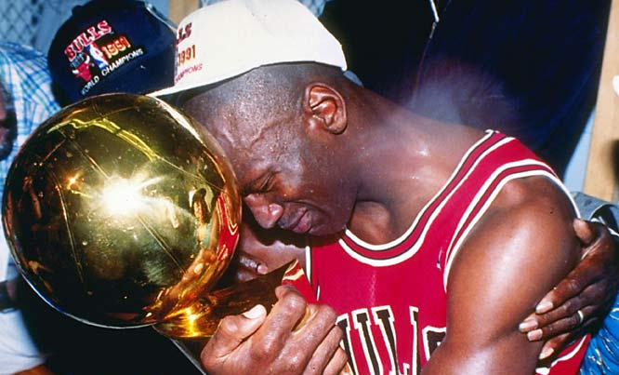
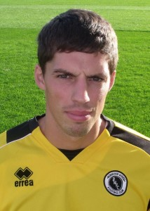
Different Entities with the Same Name
Michael Jordan

Slide 5
Knowledge Bases
e.g. Yago, DBpedia

Slide 6
Question
Michael Jordan won his first NBA championship in 1991.
m : entity mention
e : an entity in Knowledge Base
Michael Jordan
(Person)

Slide 7
LINDAN framework
Assumption : that the named entity recognition process has been completed
Goal : linking the detected named entity mention with the knowledge base
Tool : Yago, Wikipedia-Miner

Slide 8
Outline
Introduction
Approach
Experiment
Conclusion

Slide 9
LINDEN Framework
d : a document to be processed
E₀ : All candidate entities
Score_{m}(e) : Score of entity
d
Candidate Entity Generation
Name Entity Disambiguation
Unlinkable Mention Prediction
E₀
Score_{m}(e)

Slide 10
Candidate Entity Generation
Build a dictionary from Wikipedia
Lookup the dictionary
Entity pages
Redirect pages
Disambiguation pages
Hyperlinks

Slide 11
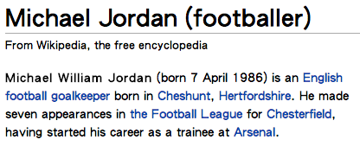
Entity pages
Michael Jordan
Michael Jordan(footballer)

Slide 12
Redirect pages

Slide 13
Disambiguation pages

Slide 14
Hyperlinks

Slide 15
Look up the dictionary
Count is the number of links which point to the entity.

Slide 16
Link Probability
e.g. LP(Michael I. Jordan | m) = 10/(65+10+7+3)
P.S. The candidate entities with very low link probability
will be discarded .

Slide 17
LINDEN Framework
d : a document to be processed
E₀ : All candidate entities
Score_{m}(e) : Score of entity
d
Candidate Entity Generation
Name Entity Disambiguation
Unlinkable Mention Prediction
E₀
Score_{m}(e)

Slide 18
Name Entity Disambiguation
Steps :
Semantic Network Construction
Semantic Associativity
Semantic Similarity
Global Coherence
Candidates Ranking

Slide 19
Candidates Ranking
Feature vector :
Score :
a set of labeled documents as training data
Feature Vector
SVM

Slide 20
Name Entity Disambiguation
Steps :
Semantic Network Construction
Semantic Associativity
Semantic Similarity
Global Coherence
Candidates Ranking ✔

Slide 21
Semantic Network Construction
Tool : Yago, Wikipedia-Miner

Slide 22
Example of Semantic Network Construction

Slide 23
Steps
Find candidate entities by the dictionary
Use Wikipedia-Miner to find the context concept.
Find other Wikipedia articles.
Use Yago to find the taxonomy relations.

Slide 24
Name Entity Disambiguation
Steps :
Semantic Network Construction ✔
Semantic Associativity
Semantic Similarity
Global Coherence
Candidates Ranking ✔

Slide 25
Semantic Associativity
E1 and E2 are the sets of Wikipedia concepts that link to e1 and e2

Slide 26
Examples of SmtAss
SmtAss(Michael J. Jordan, Chicago Bulls) =
SmtAss(National Basketball Association, Chicago Bulls) =

Slide 27
Name Entity Disambiguation
Steps :
Semantic Network Construction ✔
Semantic Associativity ✔
Semantic Similarity
Global Coherence
Candidates Ranking ✔

Slide 28
Semantic Similarity (1)
Given two Wikipedia concepts e1 and e2, we assume thesets of their super classes are Φe1and Φe2 , respectively.
C0
C2
Cb
C1
Ca

Slide 29
Semantic Similarity (2)
P(C) is the probability that a randomly selected object belongs to the subtree with the root of C in the taxonomy.
C0 is the root of the smallest subtree that contains both C1 and C2 in the taxonomy.

Slide 30
Examples
sim(C1, C2) =
sim(C1, Cb) =

Slide 31
Semantic Similarity (3)
the set of k context concepts in Γd which have the highest semantic similarity with entity e as Θk

Slide 32
Name Entity Disambiguation
Steps :
Semantic Network Construction ✔
Semantic Associativity ✔
Semantic Similarity ✔
Global Coherence
Candidates Ranking ✔

Slide 33
Global Coherence

Slide 34
LINDEN Framework
d
d : a document to be processed
E₀ : All candidate entities
Score_{m}(e) : Score of entity
Candidate Entity Generation
Name Entity Disambiguation
Unlinkable Mention Prediction
E₀
Score_{m}(e)
Learn the threshold τ to validate the predicted entity

Slide 35
Outline
Introduction
Approach
Experiment
Conclusion

Slide 36
Experiment
Data Set : CZ, TAC-KBP2009 data
Using 10-fold cross validation

Slide 37
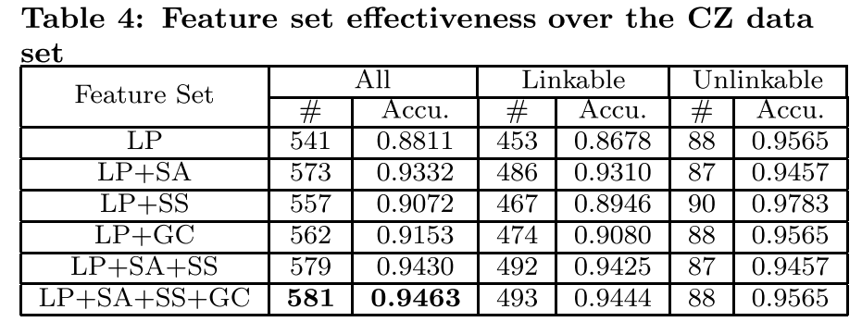
CZ

Slide 38
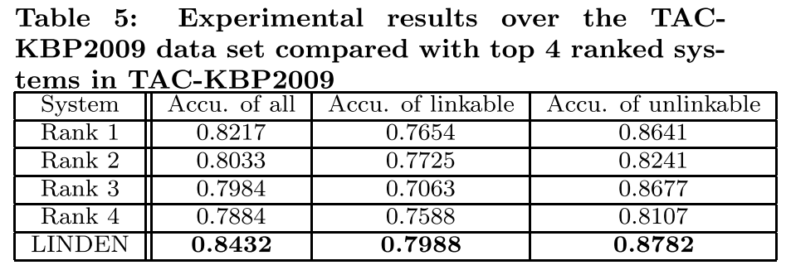
TAC-KBP2009

Slide 39
Outline
Introduction
Approach
Experiment
Conclusion

Slide 40
Conclusion
Entity linking is a very important task for many applications such as Web people search, question answering and knowledge base population.
This paper, propose LINDEN, a novel framework to link named entities in text with YAGO knowledge base.

